Slide 1


Liberia COVID-19 Daily Sitrep 410 (29th April 2021)

Slide 2
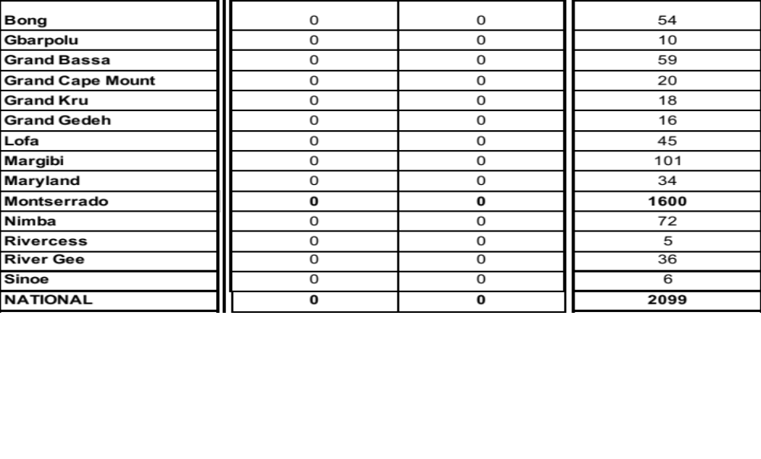
Summary of COVID-19 Cases by Reporting County, Liberia,
16 March 2020 – 29 April 2021

Slide 3
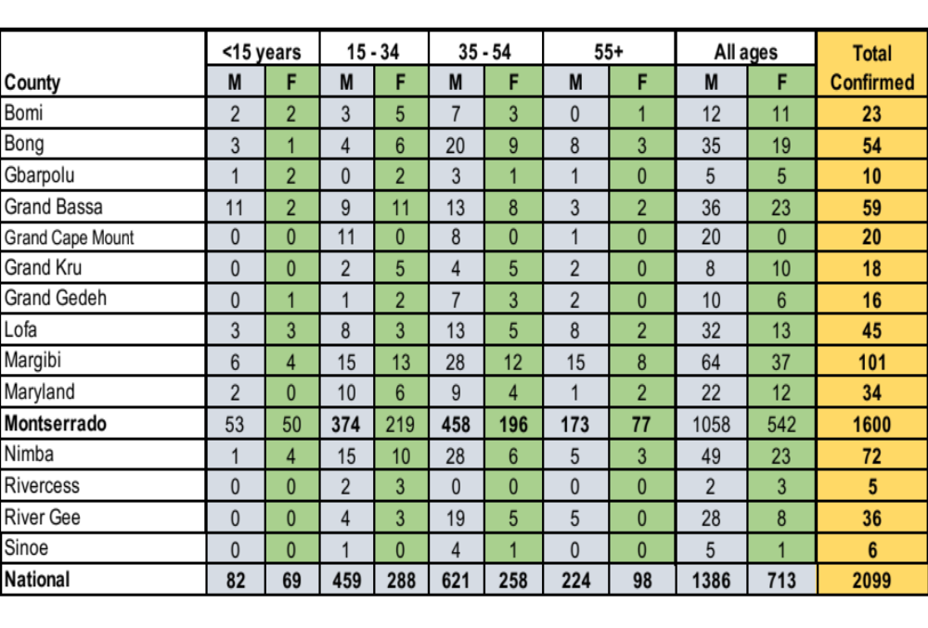
Demographic Breakdown (Gender & Age) of Confirmed COVID-19 Cases (16 March 2020 – 29 April 2021)

Slide 5
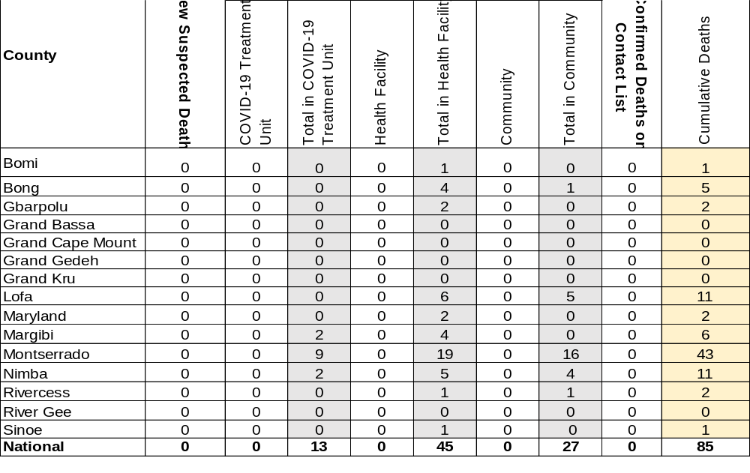
Summary of COVID-19 Deaths by Reporting County, Liberia,
16 March 2020 – 29 April 2021
The Liberia Case Fatality rate (CFR) officially considered is for deaths that occurred among patients in care at the COVID-19 treatment units across the country. As of 30 December 2020 , a total of 13 deaths have been recorded CFR=1.3%. The country is however keeping active surveillance on community deaths and deaths in non COVID-19 treatment health units.

Slide 6
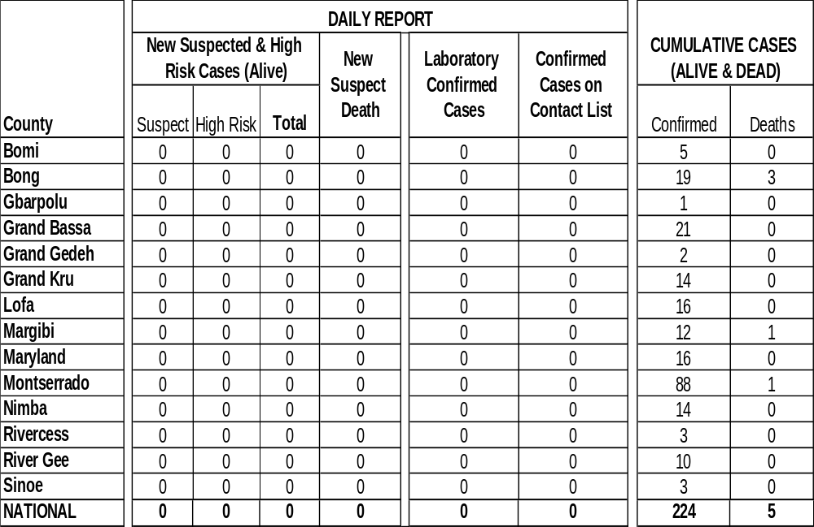
Daily and Cumulative Healthcare Worker (HCW) COVID-19 Cases and Deaths by County, Liberia, 16 March 2020 – 29 April 2021

Slide 7
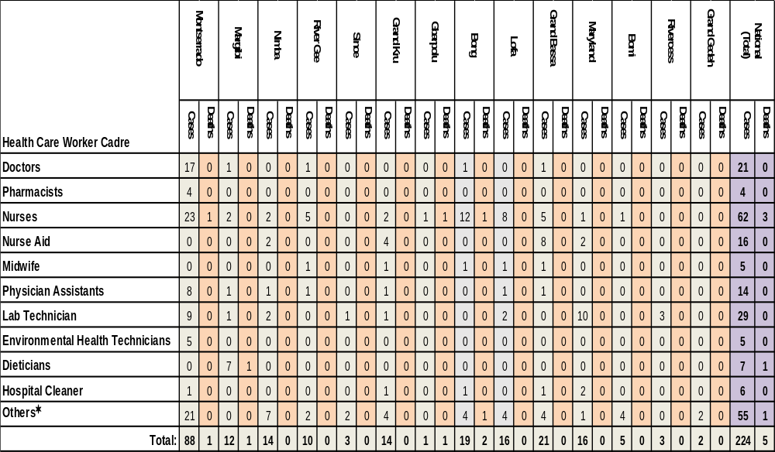
Cadre Cases and Deaths by Health Care Workers
(16 March 2020 – 29 April 2021)
*Others include the following:
Radiologist, Microbiologist, Epidemiologist, Dispenser, Licensed Practical Nurse, Psychosocial worker, Hygienist, Logistician, Vaccinator, Ambulance Driver, Procurement Officer, Registrar, Accountant, Secretary, Hospital Administrator, Community Health Volunteer, GIS Specialist, EOC Coordinator

Slide 9
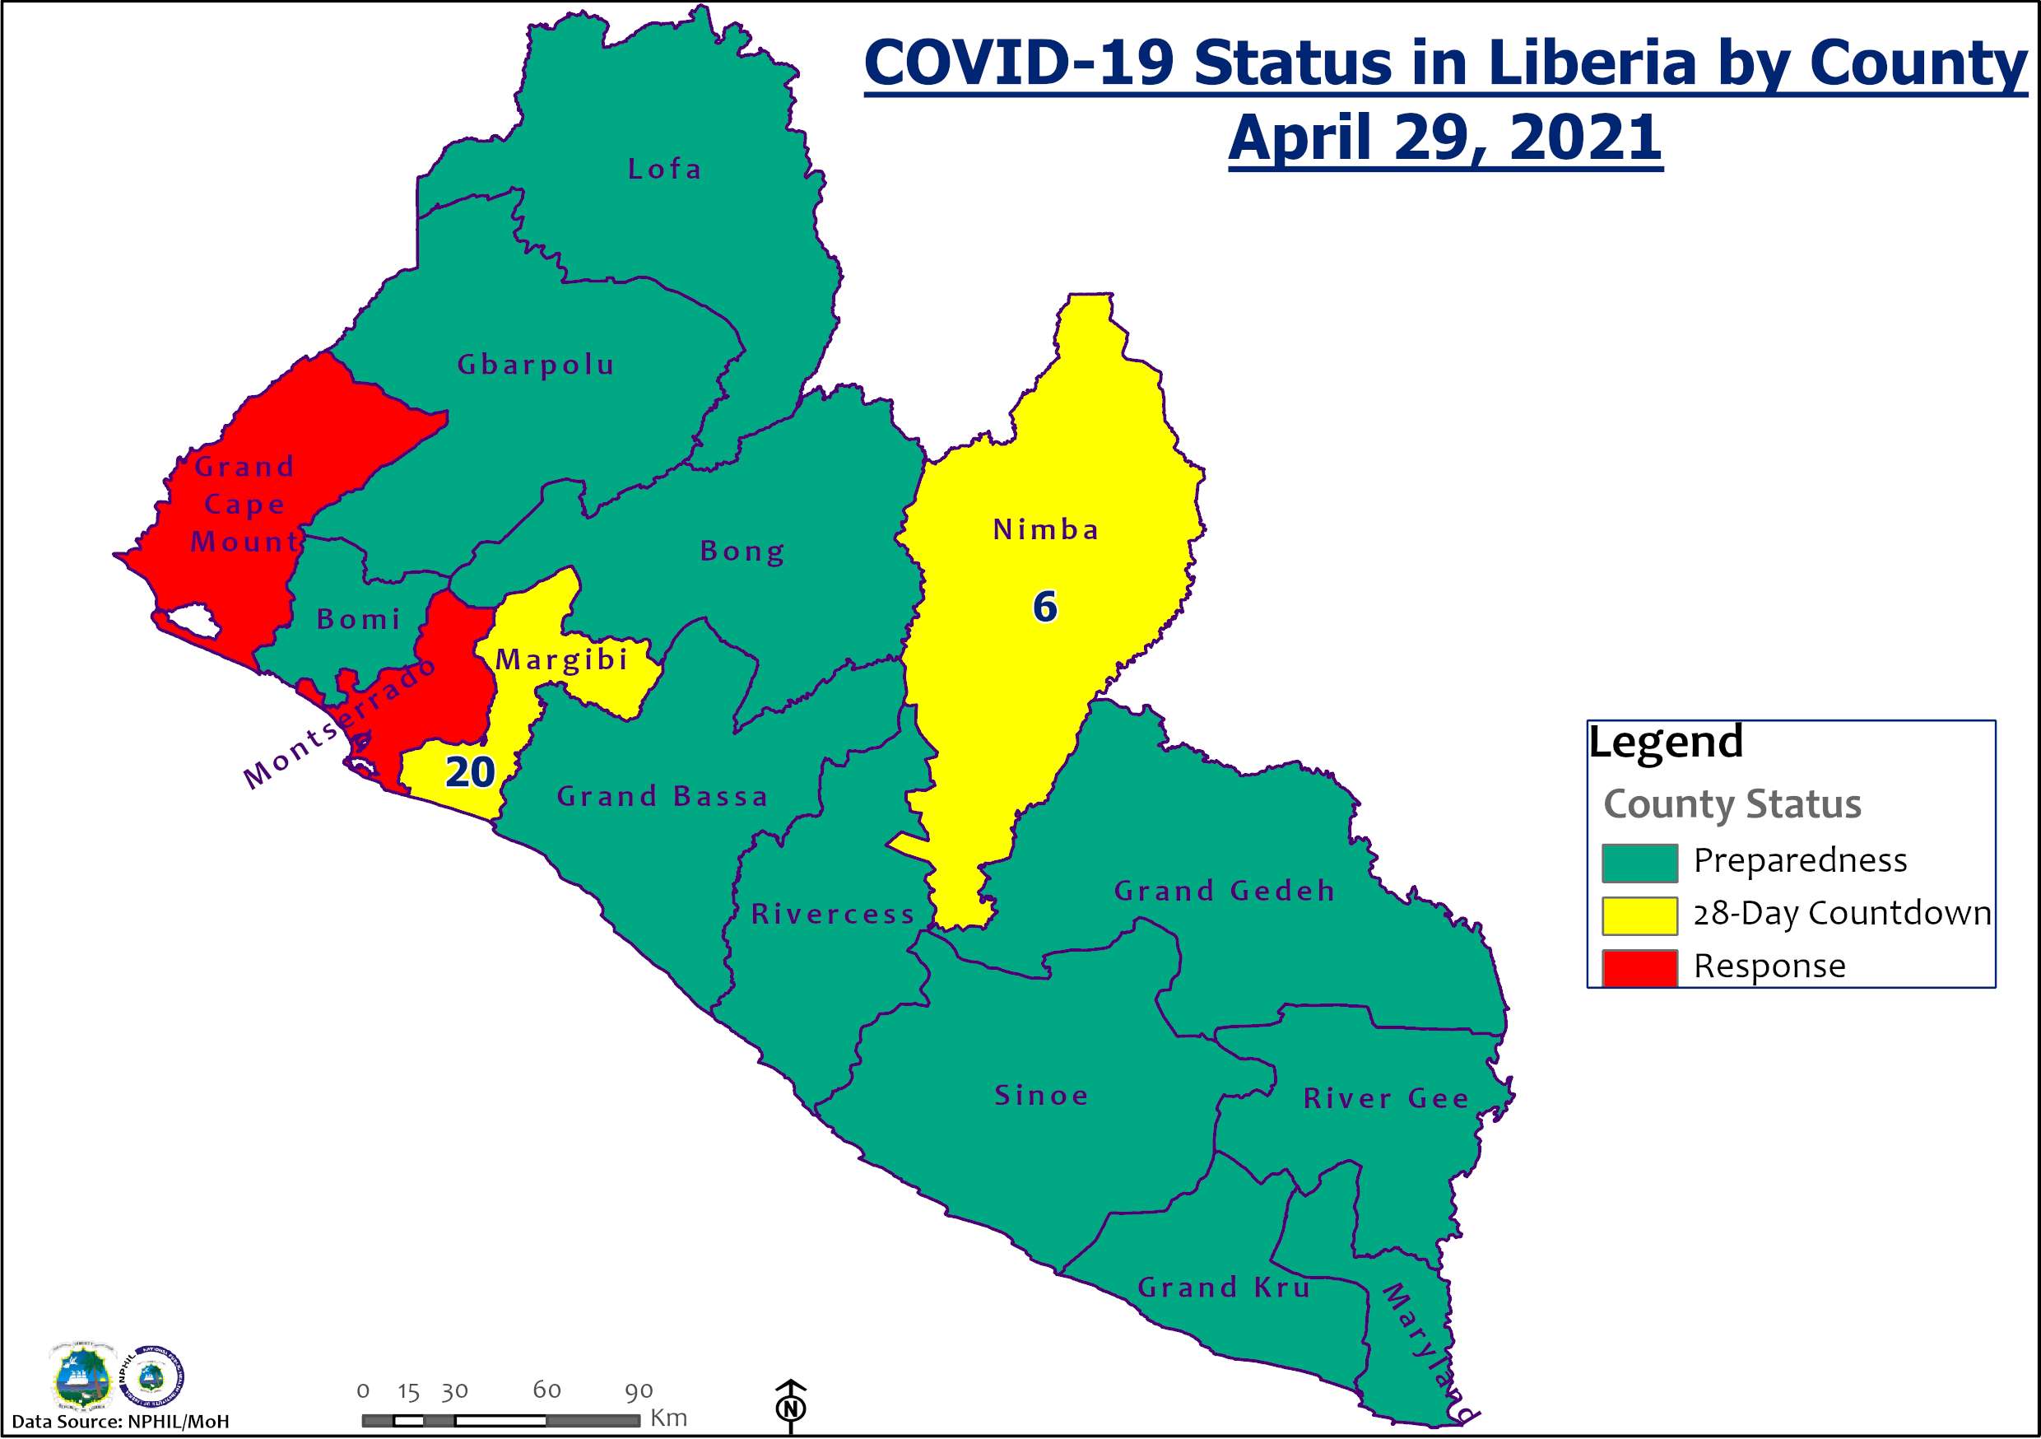

Slide 10
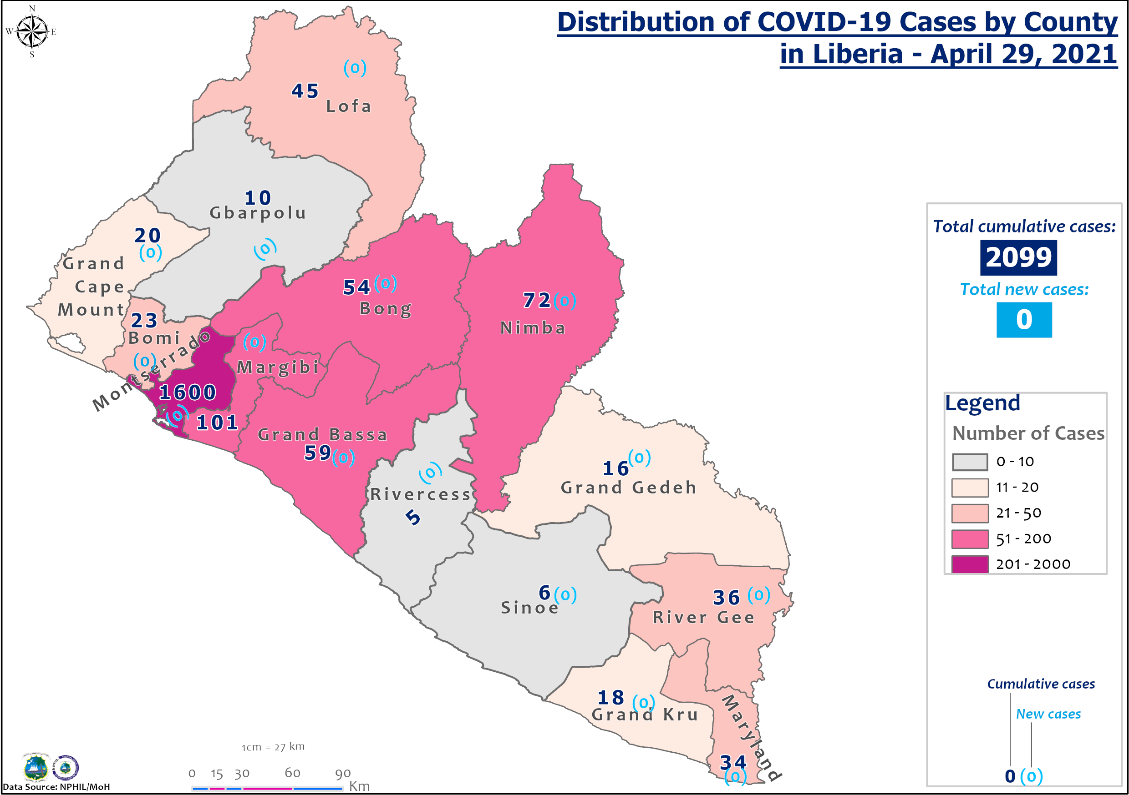

Slide 11
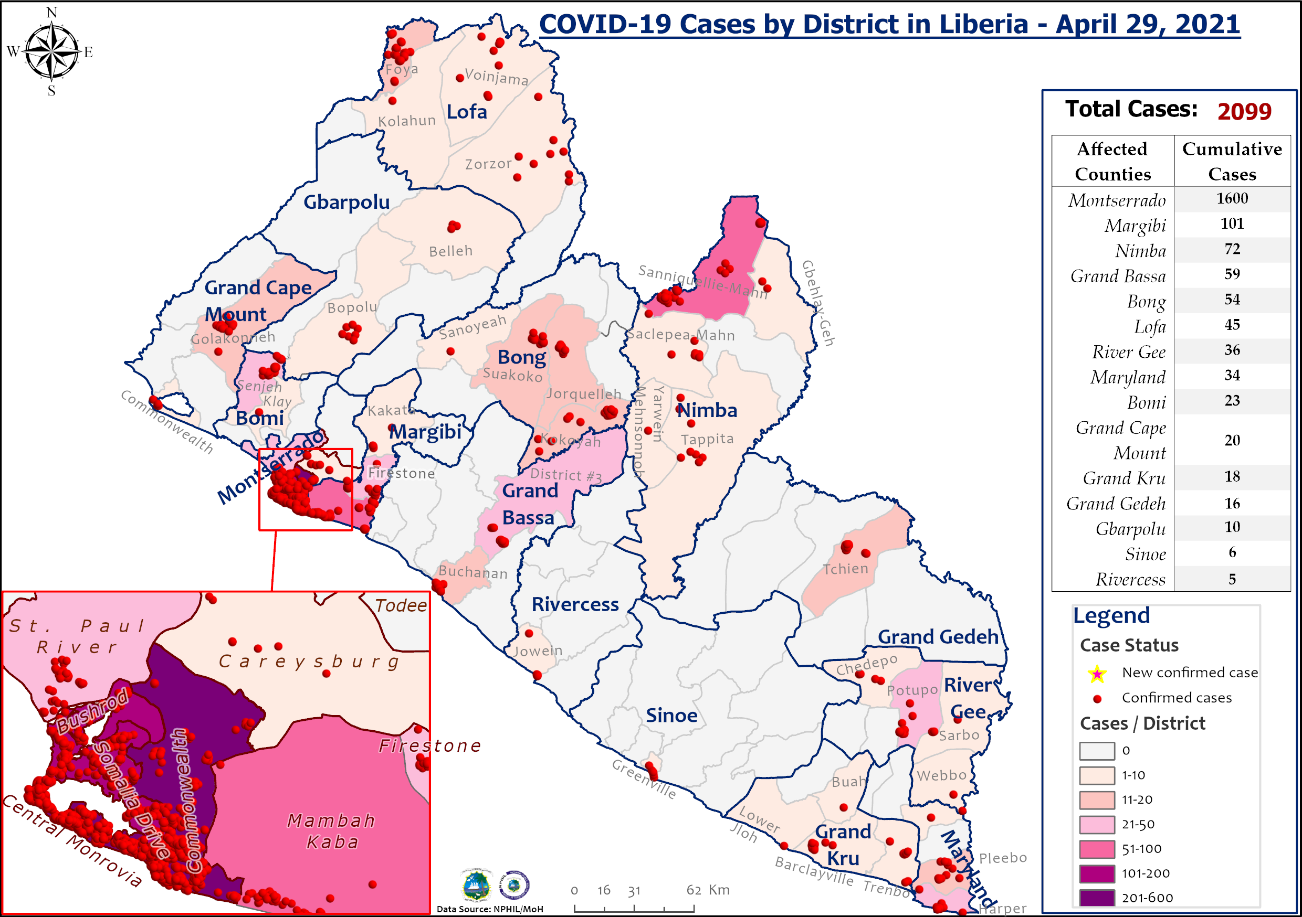

Slide 12
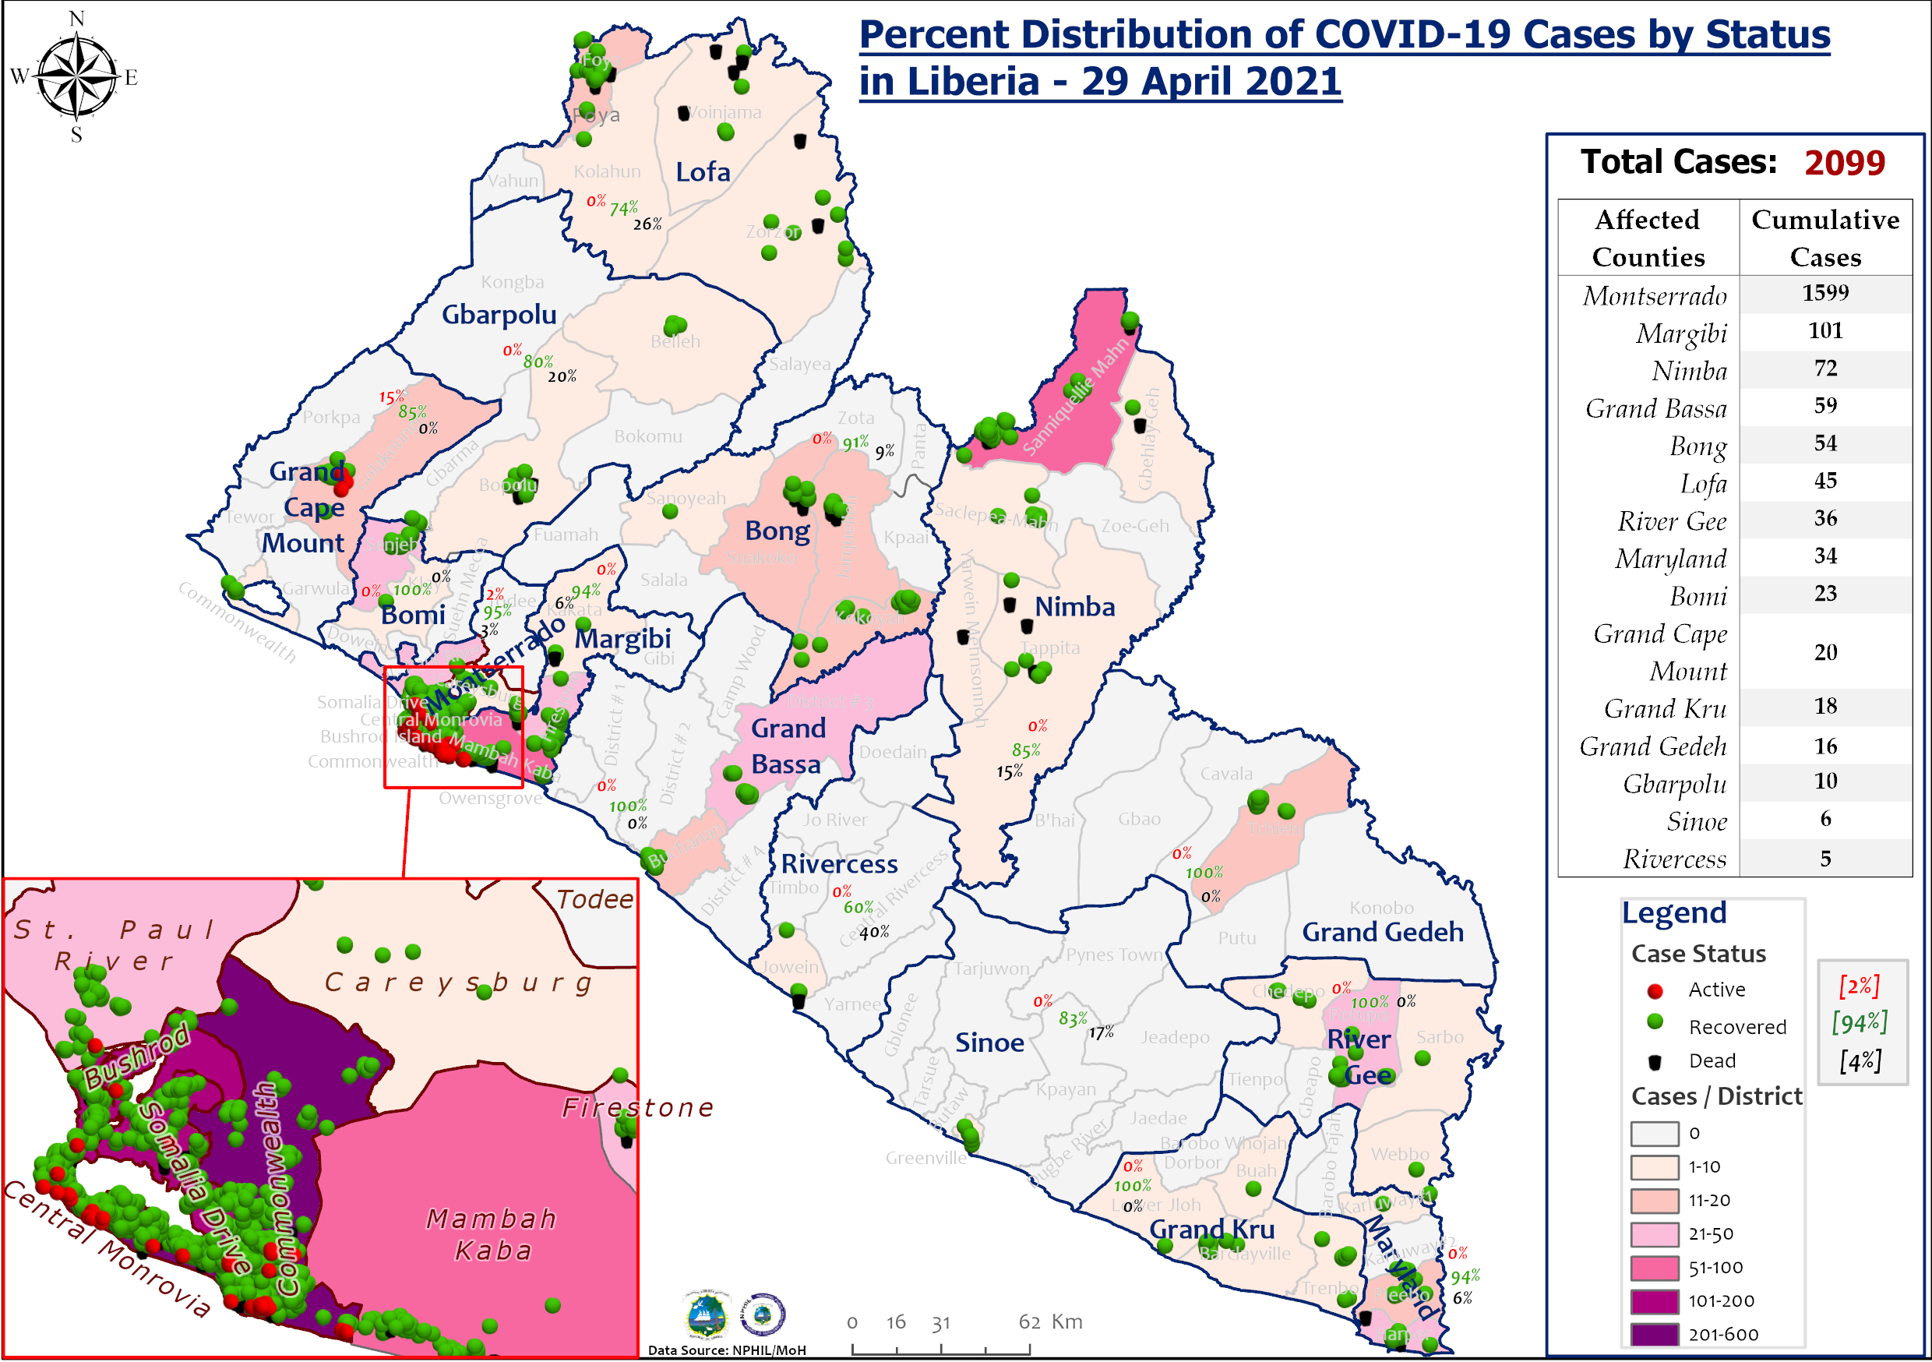

Slide 13
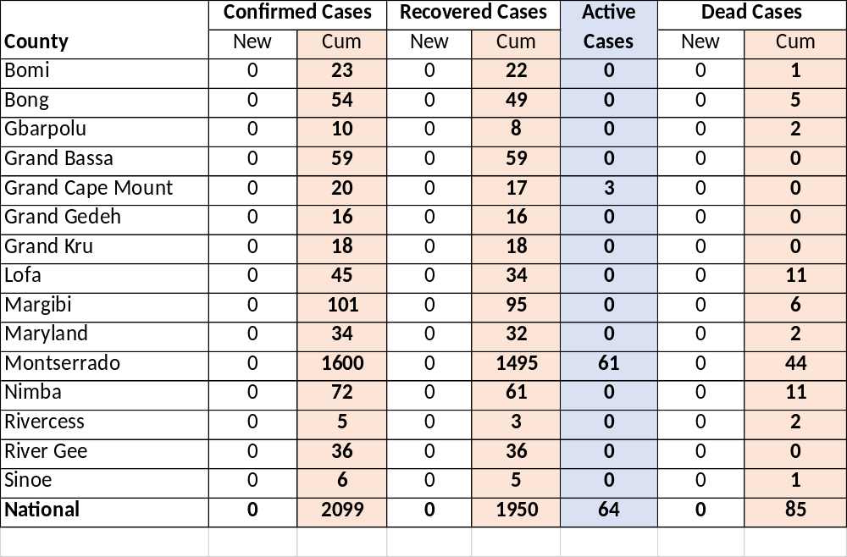
Summary of confirmed, recovered, active, and dead cases by reporting counties, Liberia, 16 March 2020 – 28 April 2021
*The cases in Grand Cape Mount are being managed at home

Slide 14
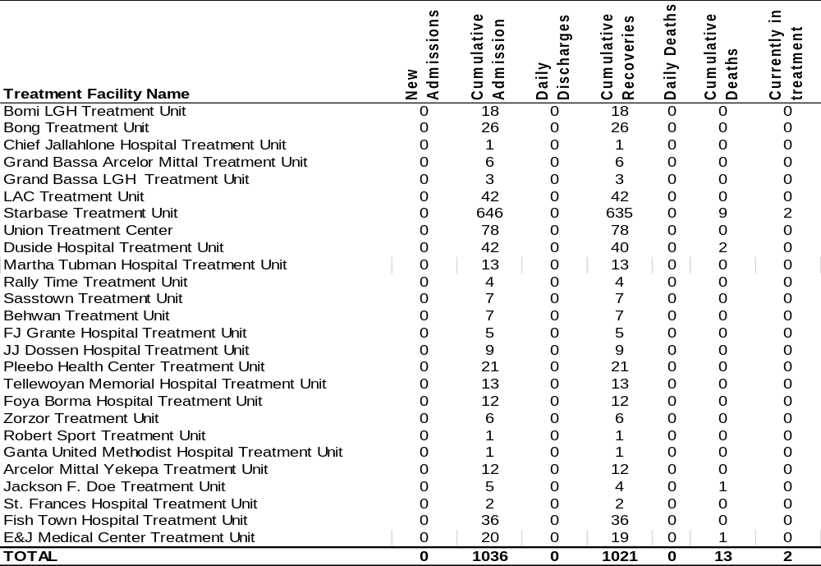
Daily Summary Report at Treatment Units – 29 April 2021

Slide 15
Home-Base Care of COVID-19 Cases
County | New Admissions | Currently in Admissions | No. Followed-up (In-person/Phone) | Cumulative Admissions | New Recoveries | Cumulative Recoveries | Referrals to TU | Cumulative Referrals to TU | New Death | Cumulative Deaths
Montserrado | 0 | 11 | 11 | 231 | 0 | 217 | 0 | 7 | 0 | 0
Grand Cape Mount |  |  |  | 0
Total: | 0 | 11 | 11 | 231 | 0 | 217 | 0 | 7 | 0 | 0

Slide 16
Laboratory Samples Evaluated – 29 April 2021
County | Sample Evaluated | New Positive | Repeat Positive | Initial Negative | Repeat Test Negative | Pending Lab Result
Bong | 6 | 0 | 0 | 6 | 0 | 0
Grand Bassa | 5 | 0 | 0 | 5 | 0 | 0
Grand Cape Mount | 23 | 0 | 0 | 23 | 0 | 0
Margibi | 21 | 0 | 0 | 21 | 0 | 0
Montserrado | 373 | 0 | 0 | 373 | 0 | 0
Nimba | 8 | 0 | 0 | 8 | 0 | 0
TOTAL | 436 | 0 | 0 | 436 | 0 | 0
Outgoing Traveler | 155 | 0 | 0 | 155 | 0 | 0
Incoming Traveler | 278 | 0 | 0 | 278 | 0 | 0
Voluntary | 3 | 0 | 0 | 3 | 0 | 0
NRL | 431 | 0 | 0 | 431 | 0 | 0
UN Clinic Lab | 5 | 0 | 0 | 5 | 0 | 0
Notes:
The information in here is generated from the laboratory results for that day. All of the information for travelers are also part of the spreadsheet from the lab

Slide 17
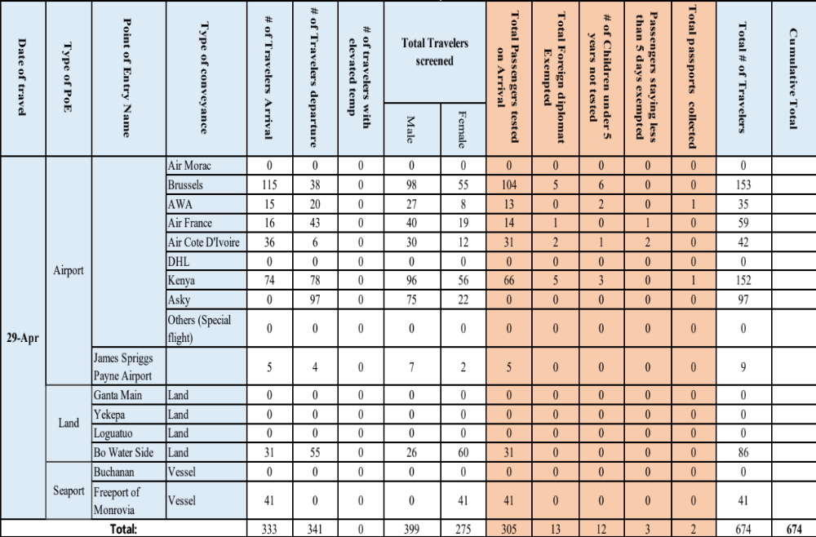
Summary of COVID-19 Daily PoE in Response Counties (29 April 2021)

Slide 18
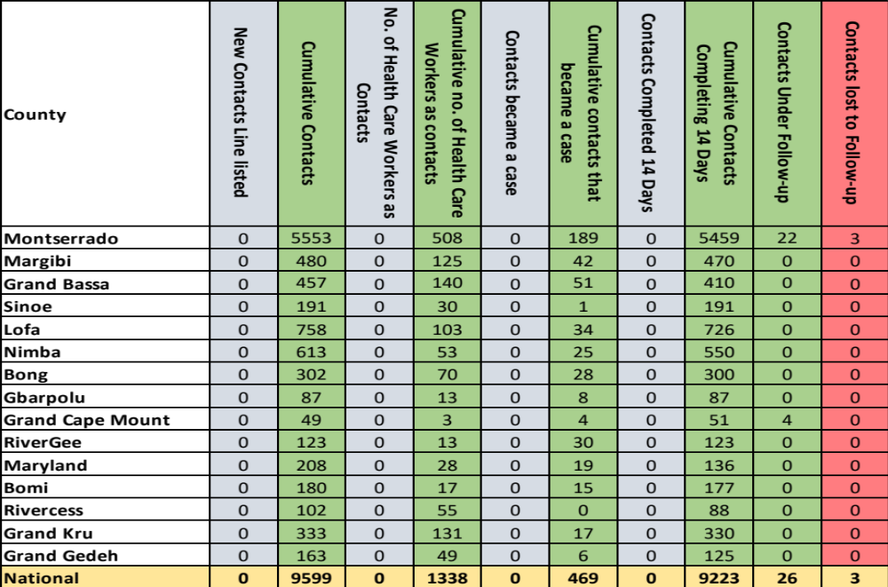
Summary of COVID-19 Contact Tracing in Response Counties
Notes:
Counties in response mode are expected to email their daily report to workinggroupliberia@gmail.com for inclusion but unfortunately, we have to contact the counties. For Montserrado, we often contact Cyrus Kamba: +231777390750

Slide 19
Thank you for Listening

